Slide 1
Software Engineering
Program Educational Objectives Mappimg:
Preparation: To prepare students for placement in reputed industries or to excel in higher studies or entrepreneurship (1)
Core Competence: To train students on application of basic principles in Mathematics, Science and Computer Engineering for solving Engineering/ Business problems, and designing systems and products (2)
Professionalism: To inculcate professional ethics as the basic principle and soft skills to develop professionalism among the students (4)

Slide 2
Software Engineering
Program Outcomes Mapping:
an ability to apply knowledge of Mathematics,
Science, and Engineering (a).
an ability to design and conduct experiments, as
well as to analyze and interpret data (b).
an ability to design a system, component, or process
to meet desired needs within realistic constraints
such as economic, environmental, social, political,
ethical, health and safety, manufacturability, and
sustainability (c)
an ability to identify, formulate, and solve
engineering problems (e)

Slide 3
Software Engineering
Program Outcomes Mapping (Contd) :
an understanding of professional and ethical
responsibility (f)
an ability to communicate effectively (g)
the broad education necessary to understand the
impact of engineering solutions in a global,
economic, environmental, and societal context (h)
a knowledge of contemporary issues (j)
an ability to apply systems approach for problem
solving (n)

Slide 4
Software Engineering
Contents Beyond Syllabus :
Program Educational Objectives : 1, 2, 4
Defined Program Outcomes : a, b, c, e, f, g, h, j,
k, l, m, n
Attainable Program Outcomes : a, b, c, e, f, g, h, j,n
Gap between Defined & Attainable Program
Outcomes : k, l
Contents Beyond Syllabus :
Introduction to Software Engineering tools –
Rational Rose
Case study

Slide 5
Software Engineering
Unit I : Introduction to Software Engineering
Introduction : Nature of software, Software
Process, Software Engineering Practice, Software
Myths, Generic Process Model
Process Models : Waterfall Model, Incremental
Models, Evolutionary Models, Concurrent Process
Model, Specialized process Models
Personal & Team Process Models
Agile process Models : Agile Process, Extreme
Programming (XP)
S

Slide 6
What is Software?
What are the characteristics of Software?
Nature of Software
Software Myths
Software Engineering Practice
Framework Activities
Umbrella Activities

Slide 7
What is Software?
Set of programs
Data Structures
Documentation :

Slide 8
What are the characteristics of Software?
Logical rather than Physical
Software is developed or engineered, it is not
manufactured (Quality, People, Process,
Cost)
Software does not wear out (Bathtub Curve)
Moving towards component based
construction, however most of the software is
custom built

Slide 9
Hardware vs. Software
Hardware | Software
Manufactured Wears out Built using components Relatively simple | Developed/Engineered Deteriorates Custom built Complex
9

Slide 10
Manufacturing vs. Development
Once a hardware product has been manufactured, it is difficult or impossible to modify. In contrast, software products are routinely modified and upgraded.
In hardware, hiring more people allows you to accomplish more work, but the same does not necessarily hold true in software engineering.
Unlike hardware, software costs are concentrated in design rather than production.
10

Slide 11
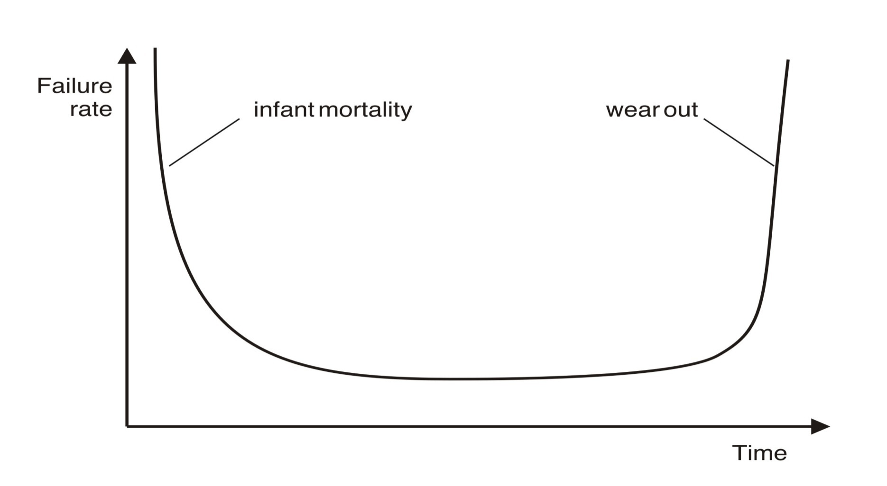
Wear vs. Deterioration
Hardware wears out over time
11

Slide 12
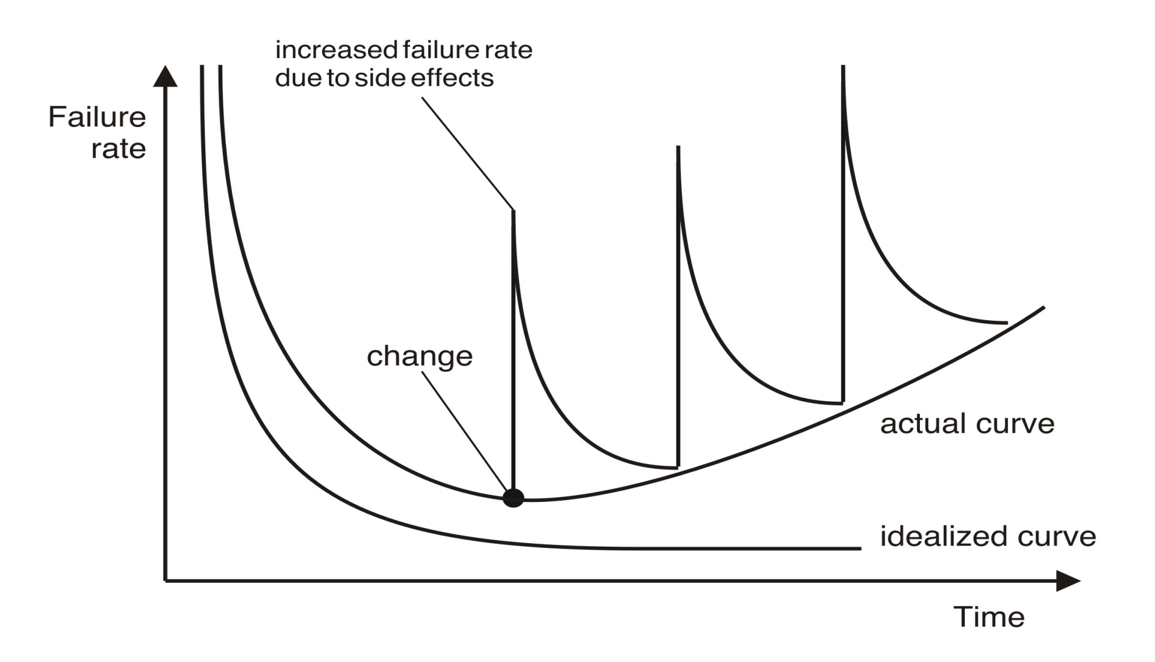
Wear vs. Deterioration
Software deteriorates over time
12

Slide 13
Software Complexity
“I believe the hard part of building software to be the specification, design, and testing of this conceptual construct, not the labor of representing it and testing the fidelity of the representation”.
If this is true, building software will always be hard. There is inherently no silver bullet.
- Fred Brooks, “No Silver Bullet”
http://www.computer.org/computer/homepage/misc/Brooks/
13

Slide 14
Nature of Software
Systems Software
Applications Software
Engineering / Scientific software
Embedded Software
Product Line Software
Web Applications
Artificial Intelligence Software
Ubiquitous Software
Net sourcing
Open Source

Slide 15
Software Myths
Management Myths
Customer Myths
Practitioners Myth

Slide 16
Software Myths
Management Myths
We are already having a book that is full of
Standards & Procedures for building
software. It will provide my people everything
they need to know.
If we get behind schedule, we can add more
developers & catch up.
We can outsource the software project to a
third party. I can just relax & let that firm build
it.

Slide 17
Software Myths
Customer Myths
A general statement of objectives is
sufficient to begin writing programs.
We can fill in the details later
Project requirements continually
change, but the change can be easily
accommodated because software is
flexible

Slide 18
Software Myths
Practitioners Myth
Once we write the program and get it to work our job is
done
Until I get the program running, I have no way of
accessing its quality
The only deliverable work product for a successful
project is the working program
Software Engineering will make us create voluminous &
unnecessary documentation & invariably slow us down

Slide 19
Software Engineering – A layered Technology
Software Engineering is the application of systematic, disciplined, quantifiable
approach to the development, operation
and maintenance of software i.e. the
application of engineering to software
[ IEEE definition ]

Slide 20
A Layered Technology
Software Engineering
tools
methods
process model
a “quality” focus
20

Slide 21
Software Engineering Layers
Quality Focus : Organizational commitment to
quality ( TQM, Six Sigma )
Process : Defines a framework (Foundation
for Software Engineering)
Methods : “How to”s for building software
(Tasks)
Tools : Automated or semi-automated
support (Rational Rose, CASE
tools)

Slide 22
Framework Activities
Communication
Planning
Modeling
Construction
Deployment

Slide 23
A Process Framework
Software process
Process framework
Umbrella activities
framework activity #1
framework activity #2
SE action #1.1
SE action #2.1
task sets | ⎧ ⎨ ⎩ | work tasks work products QA points milestones
task sets | ⎧ ⎨ ⎩ | work tasks work products QA points milestones
SE action #1.2
SE action #2.2
task sets | ⎧ ⎨ ⎩ | work tasks work products QA points milestones
task sets | ⎧ ⎨ ⎩ | work tasks work products QA points milestones
23

Slide 24
Umbrella Activities
Software Project Tracking & Control
Risk Management
Software Quality Assurance
Formal Technical Reviews
Measurement
Software Configuration Management
Reusability Management

Slide 25
Software Engineering Practice
Practice is collection of Concepts, Principles, Methods & Tools that a software engineer calls upon on a daily basis.
Practice allows Managers to manage software projects & Software Engineers to build computer programs.

Slide 26
The Essence of SE Practice
Understand the Problem – Communication & Analysis
Plan a Solution – Modeling & Software Design
Carry out the Plan – Code generation
Examine the Results – Testing & QA

Slide 27
Core Principles
The Reason it all Exists
Keep It Simple, Stupid (KISS!)
Maintain the Vision
What you Produce, others will Consume
Be Open to Future
Plan Ahead for Reuse
THINK

Slide 28
Software process model
Attempt to organize the software life cycle by
defining activities involved in software production
order of activities and their relationships
Goals of a software process
standardization, predictability, productivity, high product quality, ability to plan time and budget requirements

Slide 29
Code & Fix
The earliest approach
Write code
Fix it to eliminate any errors that have been detected, to enhance existing functionality, or to add new features
Source of difficulties and deficiencies
impossible to predict
impossible to manage

Slide 30
Process Models
Prescriptive Process Models
The Waterfall Model
Incremental Model
The RAD Model
Evolutionary Process Models
The Prototyping Model
The Spiral Model
The Concurrent Development Model

Slide 31
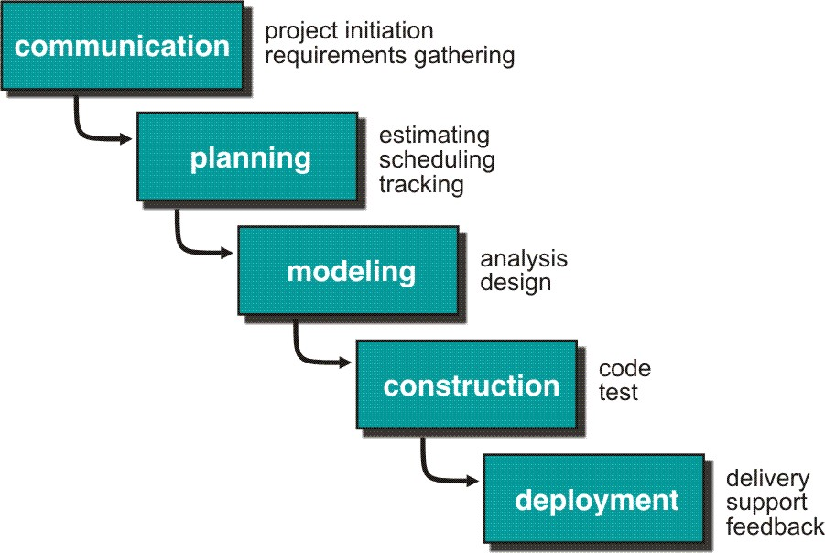
The Waterfall Model
31

Slide 32
The Waterfall Model: (Payroll System)
Merits :
It is systematic sequential approach for Software Development
Demerits
All Customer Requirements at the start of project may be difficult
Problems remain uncovered until testing phase
Customer patience is needed, working version of the software is delivered too late.

Slide 33
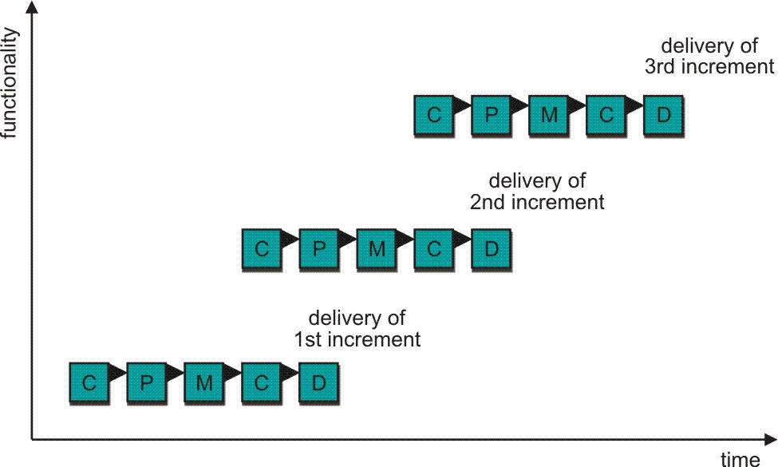
Incremental Models: Incremental
33

Slide 34
Incremental Model: (Word Processor)
Merits :
Less number of developers required
All the requirements need not be known at the beginning of the project
Technical risks can be managed
Demerits :
Problems remain uncovered until testing phase
Customer patience is needed, working version of the software is delivered too late.

Slide 35
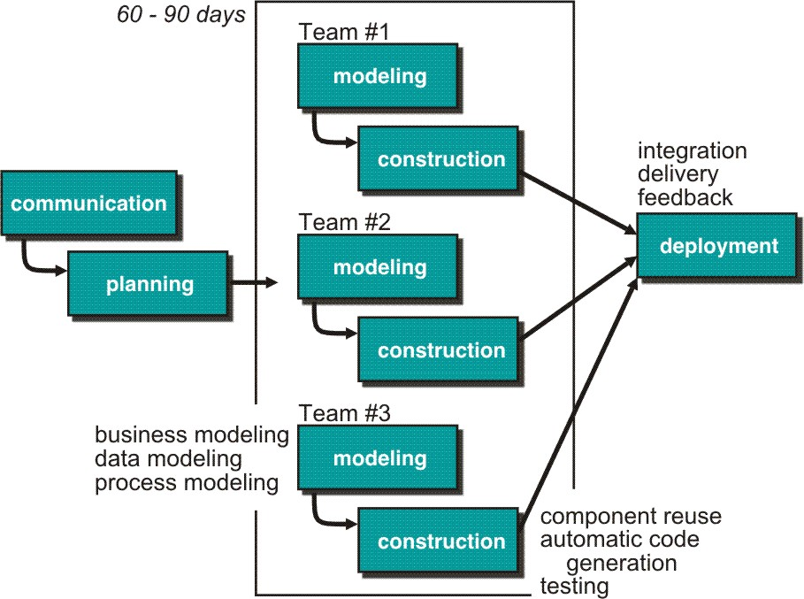
Incremental Models: RAD Model
35

Slide 36
The RAD Model : (Very Large Projects)
Merits :
Project cycle time is reduced
Demerits :
All Customer Requirements at the start of project may be difficult
For large projects high human resources are required
Risk of project failure if teams are not committed to rapid fire action
Problems due to improper modularization of system
RAD approach may mot work if high is an issue
RAD maynot be appropriate if technical risks are very high

Slide 37
Evolutionary Process Models: Need
Software like all complex systems evolves over a period
of time.
Target market deadlines make completion of a
comprehensive software product impossible, but a
limited version must be introduced to meet
competitive or business pressure. Some of the core
product or system requirements are well understood
but the details of product or system extensions have
yet to be defined.
Solution is to adapt Evolutionary Model which is
Iterative

Slide 38
The Prototyping Model: (Need)
Prototyping is used when customers requirements are
fuzzy.
OR the developer may not be sure of the efficiency of
algorithm, the adaptability of an Operating System or
the form that Human Computer interaction should
take
But we have to throw away the prototype once the
customer requirements are clear & met for better
quality. The product must be rebuilt using software
engineering practices for long term quality.

Slide 39
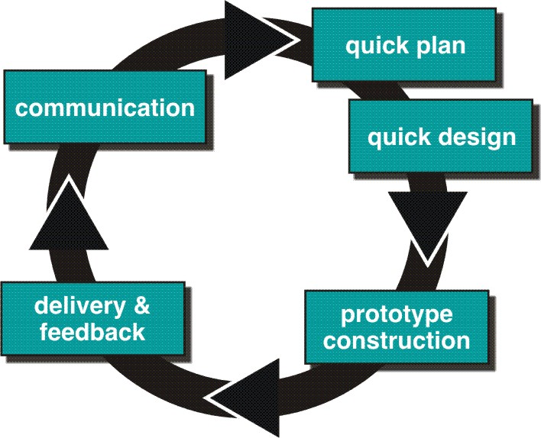
Evolutionary Models: Prototyping
39

Slide 40
The Prototyping Model:
Merits:
Prototyping helps in requirement gathering &
can be applied at any stage of the project.
Demerits:
Customer insists to convert prototype in
working version by applying “few fixes”
Developer may become comfortable with the
compromises done. “The-less-than-ideal-
choice” may become integral part of the system

Slide 41
Evolutionary Models: Spiral
Spiral Model is an evolutionary software process model that couples the iterative nature of Prototyping with controlled & systematic aspects of the Waterfall Model
Merits:
Risk is considered as each iteration is made
Spiral Model can be applied throughout the life of
the computer software.
Demerits:
It is difficult to convince customers that the
evolutionary approach is controllable
Considerable risk assessment expertise required
If major risk is uncovered, problems will occur

Slide 42
Concurrent Development Model:
The concurrent Development Model, sometimes called concurrent engineering can be represented schematically as a series of framework activities, software engineering actions and tasks, & their associated states. All activities exist concurrently.
Modeling activity (Example) :
None
Under Dev.
Awaiting Chng
Under Review
Under Rev.
Baselined
Done

Slide 43
Concurrent Development Model: Contd…
Merits:
Applicable to all types of S/W development &
provides an accurate picture of the current state of
the project.
Demerits:
Problem to Project planning. How many No of
iterations are to be planned? Uncertainty…
Process may fall in chaos if the evolutions occurs too
fast without a period of relaxation. On the other hand
if the speed is too slow productivity could be
affected.
S/W processes are focussed on flexibility & extendability, rather than on high quality.

Slide 44
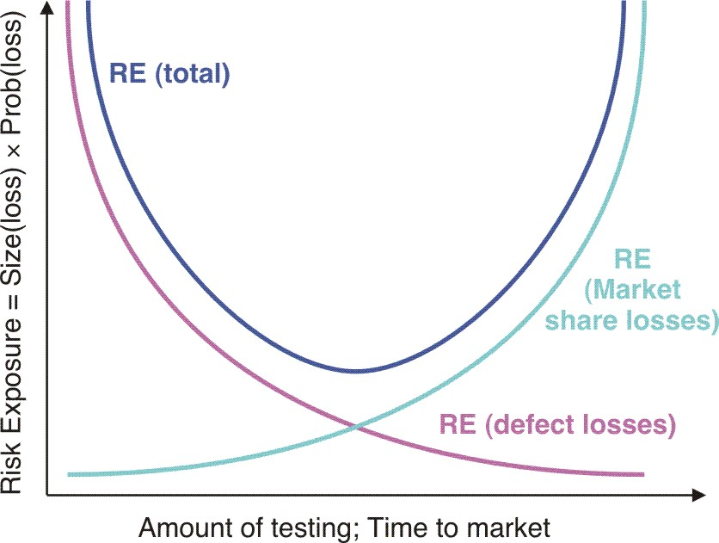
Risk Exposure
44

Slide 45
Specialized Process Models:
Specialized process models use many of the characteristics of one or more of the conventional models presented so far, however they tend to be applied when a narrowly defined software engineering approach is chosen. They include,
Components based development
The Formal Methods Model
Aspect oriented software development

Slide 46
Components Based Development :
In this approach, Commercial Off-The-Shelf (COTS) S/W components, developed by vendors who offer them as products are used in the development of software. Characteristics resemble to spiral model.
Merits:
Leads to software reuse, which provides number of
benefits
70% reduction in development cycle time
84 % reduction in project cost
Productivity index goes up to 26.2 ( Norm : 16.9)
Demerits:
Component Library must be robust.
Performance may degrade

Slide 47
The Formal Methods Model:
The formal methods model encompasses a set of activities that
lead to formal mathematical specification of computer software.
It consists of specifications, development & verification by applying
rigorous mathematical notation. Example, Clean Room S/W
Engineering (CRSE)
Merits:
Removes many of the problems that are difficult to remove using other S/W Engg. Paradigms.
Ambiguity, Incompleteness & Inconsistency can be discovered & corrected easily by using formal methods of mathematical analysis.
Demerits:
Development is time consuming & expensive
Extensive training is required
Difficult to use with technically unsophisticated customers

Slide 48
Aspect Oriented Software Development (AOSD):
A set of localized features, functions & information contents
are used while building complex software.
These localized s/w characteristics are modeled as components
(e.g. OO classes) & then constructed within the context of a
system architecture.
Certain “concerns” (Customer required properties or areas of
technical interest) span the entire architecture i.e. Cross cutting
Concerns like system security, fault tolerance etc.
Merits:
It is similar to component based development for
aspects
Demerits:
Component Library must be robust.
Performance may degrade

Slide 49
Unified Process Model
A software process that is:
use-case driven
architecture-centric
iterative and incremental
Closely aligned with the
Unified Modeling Language (UML)
49

Slide 50
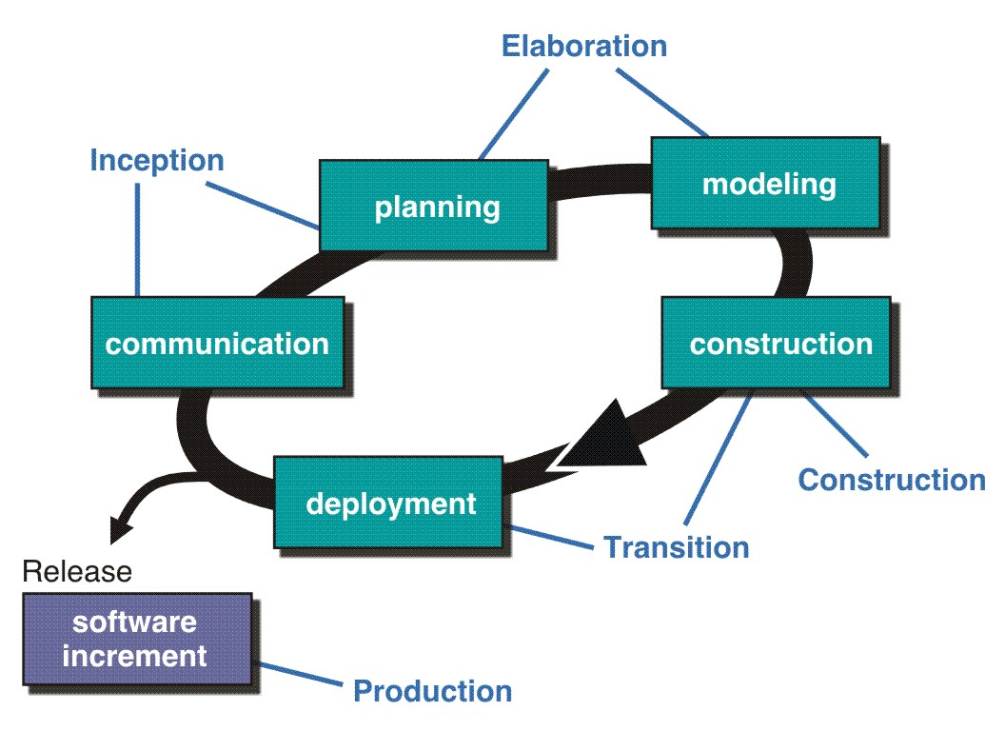
The Unified Process (UP)
inception
50

Slide 51
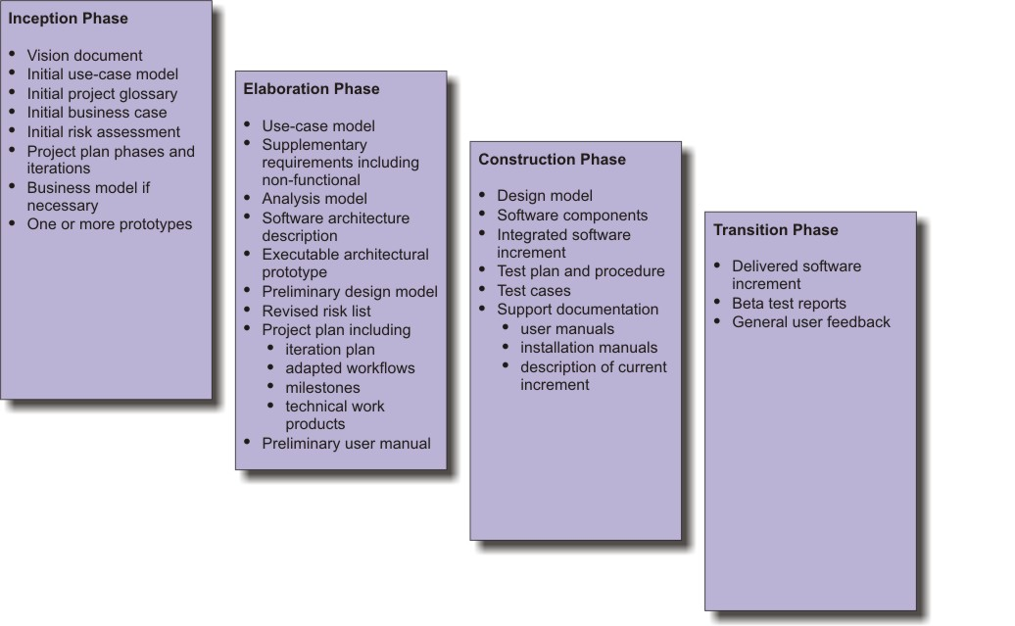
UP Work Products
inception
51

Slide 52
Common Fears for Developers
The project will produce the wrong product.
The project will produce a product of inferior quality.
The project will be late.
We’ll have to work 80 hour weeks.
We’ll have to break commitments.
We won’t be having fun.
52

Slide 53
The Manifesto for Agile Software Development
“We are uncovering better ways of developing software by doing it and helping others do it. Through this work we have come to value:
Individuals and interactions over processes and tools
Working software over comprehensive documentation
Customer collaboration over contract negotiation
Responding to change over following a plan
That is, while there is value in the items on the right, we value the items on the left more.”
-- Kent Beck et al.
53

Slide 54
What is “Agility”?
Effective (rapid and adaptive) response to change
Effective communication among all stakeholders
Drawing the customer onto the team
Organizing a team so that it is in control of the work performed
Yielding …
Rapid, incremental delivery of software
54

Slide 55
An Agile Process
Is driven by customer descriptions of what is required (scenarios)
Recognizes that plans are short-lived
Develops software iteratively with a heavy emphasis on construction activities
Delivers multiple ‘software increments’
Adapts as changes occur
55

Slide 56
Principles of Agility
Our highest priority is to satisfy the customer through early and continuous delivery of valuable software.
Welcome changing requirements, even late in development. Agile processes harness change for the customer’s competitive advantage.
Deliver working software frequently, from a couple of weeks to a couple of months, with a preference to the shorter time scale.
Business people and developers must work together daily throughout the project.
56

Slide 57
Principles of Agility
Build projects around motivated individuals. Give them the environment and support they need, and trust them to get the job done.
The most efficient and effective method of conveying information to and within a development team is face-to-face conversation.
Working software is the primary measure of progress.
Agile processes promote sustainable development. The sponsors, developers, and users should be able to maintain a constant pace indefinitely.
57

Slide 58
Principles of Agility
Continuous attention to technical excellence and good design enhances agility.
Simplicity - the art of maximizing the amount of work not done - is essential.
The best architectures, requirements, and designs emerge from self-organizing teams.
At regular intervals, the team reflects on how to become more effective, then tunes and adjusts its behavior accordingly.
58

Slide 59
Extreme Programming (XP)
The most widely used agile process, originally proposed by Kent Beck
XP Planning
Begins with the creation of user stories
Agile team assesses each story and assigns a cost
Stories are grouped to for a deliverable increment
A commitmentt is made on delivery date
After the first increment project velocity is used to help define subsequent delivery dates for other increments
59

Slide 60
Extreme Programming (XP)
XP Design
Follows the KIS principle
Encourage the use of CRC cards (see Chapter 8)
For difficult design problems, suggests the creation of spike solutions — a design prototype
Encourages refactoring — an iterative refinement of the internal program design
XP Coding
Recommends the construction of a unit test for a store before coding commences
Encourages pair programming
XP Testing
All unit tests are executed daily
Acceptance tests are defined by the customer and executed to assess customer visible functionality
60

Slide 61
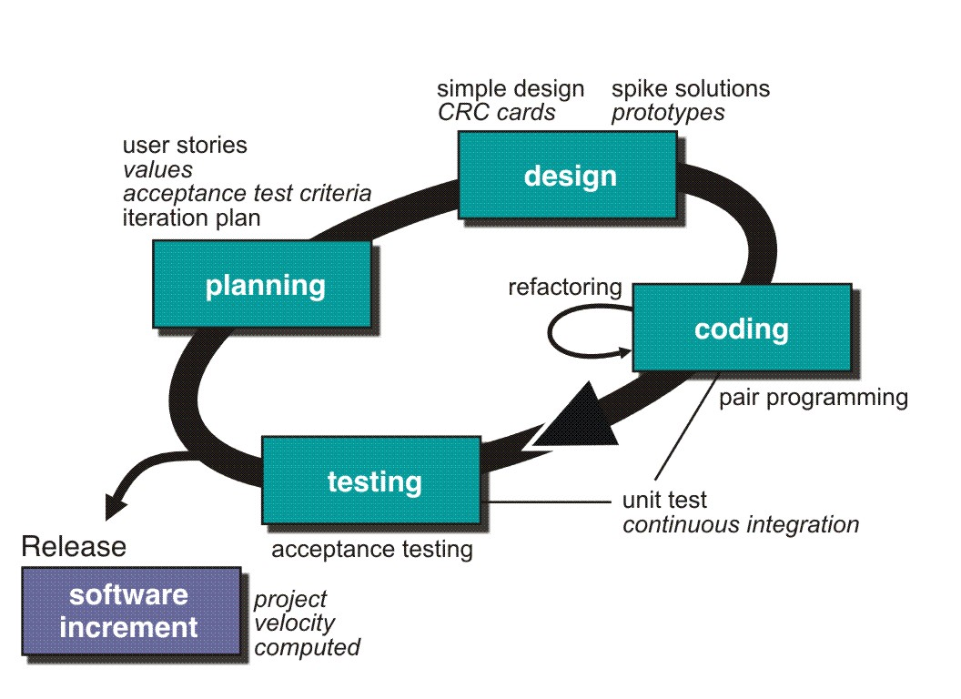
Extreme Programming (XP)
61

Slide 62
Other Agile Processes
Adaptive Software Development (ASD)
Dynamic Systems Development Method (DSDM)
Scrum
Crystal
Feature Driven Development
Agile Modeling (AM)
62

Slide 63
PSP and TSP
PSP is a high-maturity process framework for
individuals
TSP addresses high-maturity practices for teams
of PSP-trained engineers
PSP & TSP provide a set of “Hows” to the CMM’s
“Whats”
PSP & TSP get individuals and teams more
involved in process improvement
PSP & TSP are sometimes referred to as Level 5
processes for individuals and team

Slide 64
THE PSP PHILOSOPHY
Use effective methods
Recognize strengths and weaknesses
Practice, practice, practice
Learn from history
Find and learn new methods
Practice software development as an
engineering discipline rather than craft

Slide 65
What is the PSP?
The PSP is a set of practices that engineers can apply
to most structured personal tasks to improve
predictability, quality, & productivity
The PSP as taught contains one set of methods that
can be effective for many
– An excellent starting point, but not expected to
be a “one size fits all” process
Currently, few engineers practice the best available
methods, negatively impacting chances of project
success—PSP addresses this

Slide 66
What does PSP Developer DO
Tracks basic development process data
– Size, time, defects, and task completion
– Time & defects are tracked by phase, e.g., planning,
design, code, personal reviews, test, postmortem
Uses data derived from the basic data for process
management and improvement
Plans using historical data and tracks progress
– “PROBE” (PROxy Based Estimating) estimating
– “Earned Value” scheduling & tracking
– Quality planning
“Builds in” Quality
– Produces verifiable designs
– Conducts structured personal design and code reviews
Improves development process using data

Slide 67
What is the TSP?
The TSP strategy is to improve performance from the bottom up. This strategy
starts with PSP training.
Team Member Skills
Process discipline
Performance measures
Estimating and planning skills
Quality management skills
Team Building
Goal setting
Role assignment
Tailored team process
Detailed and balanced plans
Team Management
Team communication
Team coordination
Project tracking
Risk analysis
PSP TSP
Make CMM Level 5 behavior normal and expected

Slide 68
What does TSP Developer DO
Developers use PSP practices for their personal work
For each development phase (2-4 months), the team
– Conducts a team “launch” to come to a common
understanding of the project & to develop detailed
plans
– Tracks progress against schedule and quality weekly,
adjusts plans, and takes immediate action if necessary to
ensure commitments will be met
– Uses team-level data the same way as developers use
their individual data to assess schedule and quality
Quality data, Software inspections, Time on Task,
Earned value , etc.
– Conducts Postmortems to improve development process

Slide 69
Process Patterns
A Process pattern provides us with a template which provides a consistent method for describing an important characteristics of the software process
Thus software process can be defined as a collection of patterns that define a set of activities, actions, work tasks, work products and related behaviors required to develop computer software.
By combining patterns, a software team can construct a process that best meets the needs of a project.
Patterns can be defined at any level of abstraction – Complete process, framework Activity, Umbrella activity, SE action or a task

Slide 70
Process Patterns Template
Item | Contents
Pattern Name | Meaningful Name of pattern
Intent | Objective of pattern
Type | Task, SE action, Framework activity, Umbrella activity etc
Initial Context | Applicable Pre-requisites
Problem | Problem Definition
Solution | Solution to the problem / process
Resulting Context | S/W Engg. Info. & Project info. Generated after completion
Related Processes | A list of other related process patterns
Known Uses | Where it is useful & Examples where it has been used

